Slide 1

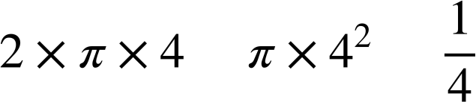
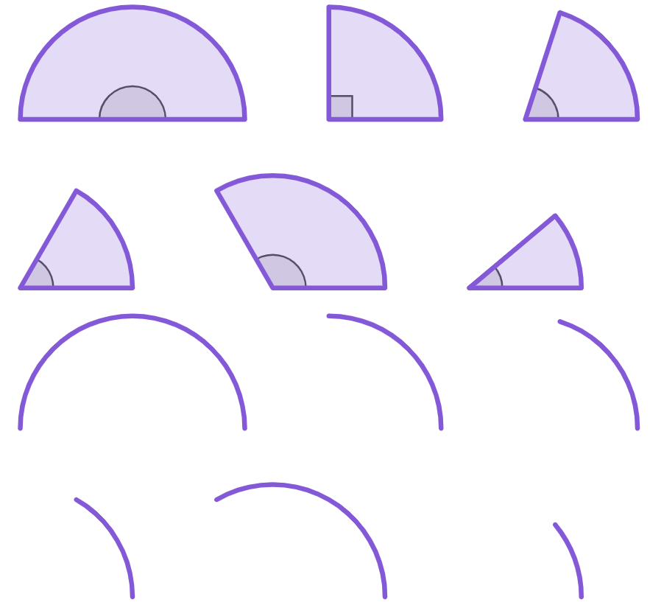

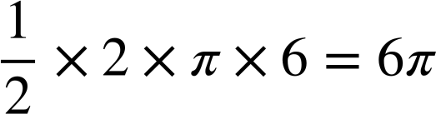
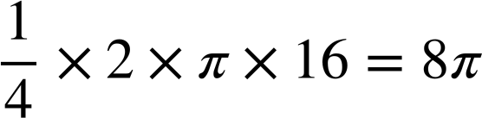

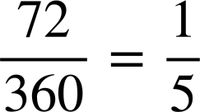
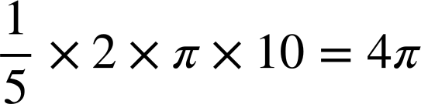

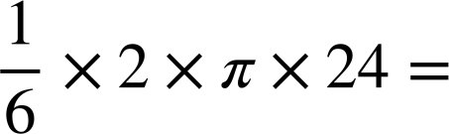

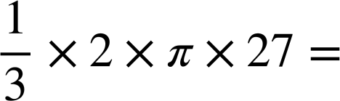

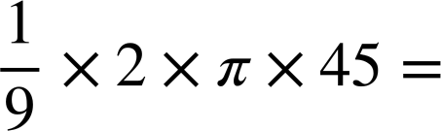
Perimeter of composite shapes
Task A: Comparing arcs and perimeters of a sector
1) The arc and sector are congruent to the one on the circle.
Complete each statement with both a calculation and an answer shown on the right.
4 cm
The circumference of this circle is
=
The arc length is
=
The perimeter of this sector is
2) Complete the table. Leave your answers in terms of π.
arc | corresponding sector | fraction of a full circle | calculations for arc length | calculations for perimeter of sector
Complete the table. Round your answers to 1 decimal place.
a)
180°
6π + 6 + 6
6 cm
6π + 12
b)
8π + 16 + 16
16 cm
8π + 32
c)
72°
4π + 10 + 10
10 cm
4π + 20
d)
25.1 + 24 + 24 =
60°
73.1 cm
24 cm
25.1 cm
e)
120°
56.5 + 27 + 27 =
27 cm
56.5 cm
110.5 cm
f)
31.4 + 45 + 45 =
40°
121.4 cm
45 cm
31.4 cm

Slide 2
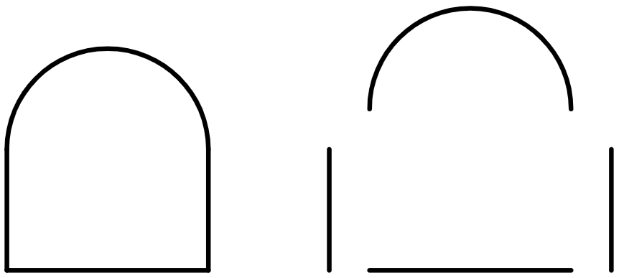
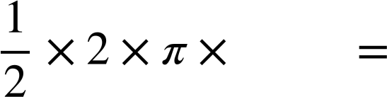
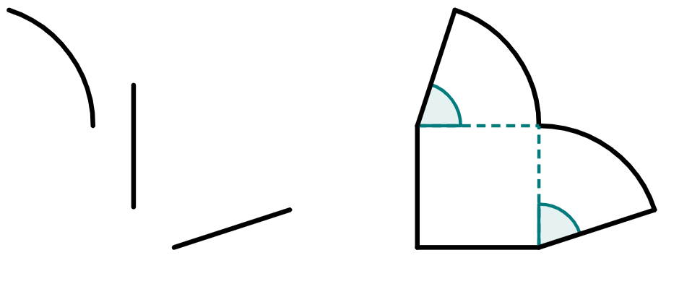
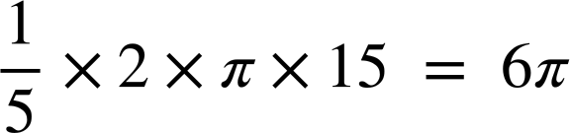
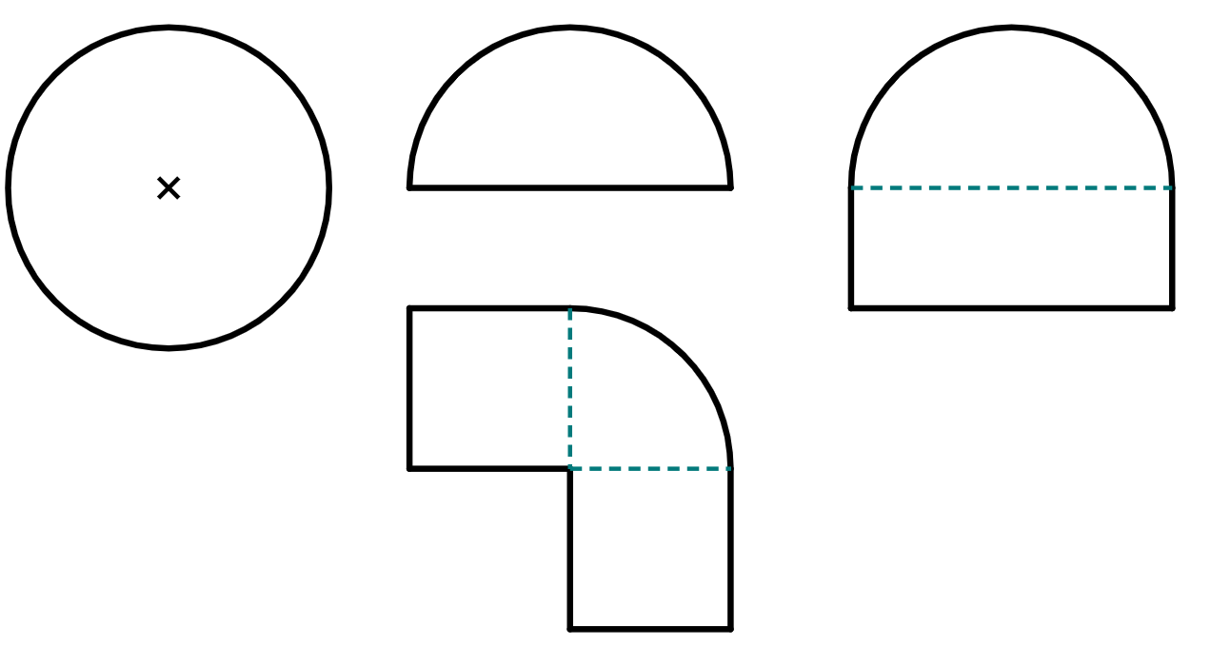

Perimeter of composite shapes
Task B: Finding perimeters of closed composite shapes
1) The composite shape has been broken down into its component lengths.
a) Write down the length of all three of these straight lines.
10 cm
10 cm
10 cm
8 cm
8 cm
b) What is the radius of this semicircle?
c) Complete this calculation to find the arc length of this semicircle.
4 cm
4
4π
____
____
d) Hence, find the total perimeter of this shape.
4π + 28 cm
2) The composite shape has been broken down into its component lengths.
a) Write down the length of all four of these straight lines.
72°
15 cm each or 60 cm total
72°
15 cm
b) What fraction of a full circle do each of these arcs represent?
⅕ each, or ⅖ for both
c) Complete this calculation to find the arc length of each arc.
d) Hence, find the total perimeter of this shape.
12π + 60
3) Starting with the smallest perimeter, sort these shapes in terms of the size of their perimeters.
a
8π = 25.1 cm
4π + 8 = 20.6 cm
b
4 cm
8 cm
d
4 cm
c
4π + 14 = 26.6 cm
2π + 24 = 30.3 cm
4 cm
4 cm
8 cm
3 cm
b
a
c
d
Mathematics in Education and Industry.
‹#›

